Slide 1

CSG1105 / CSG5130
Applied Communications
Chapter 24
Forensic Techniques

Slide 2
Objectives
Describe the makeup and purpose of a CSIRT
Explain the proper procedures utilized in digital evidence handling
Discuss the features and operation of file systems and operating systems
Describe the difference between live analysis and static analysis

Slide 3
Objectives (cont’d.)
Explain the various places to look for digital evidence
Discuss what to look for when analyzing network traffic
Describe what is needed to analyze malware
Explain the legal and ethical issues associated with computers and communication
Discuss the nature of the forensic marketplace

Slide 4
Forming a CSIRT
Computer Security Incident Response Team (CSIRT)
  Group of individuals who detect, investigate, solve, and document computer security incidents
The incident response process
  Involves seven steps
Pre-incident preparation
  Many tasks must be completed
    Before first incident ever reported

Slide 5
Forming a CSIRT (cont’d.)
Detection of incidents
  Requires routinely and timely examination of:
    Log files, security alerts, and IDS event logs
  Provides mechanism for users to report incidents
  Identifies who should be informed, how they should be informed
  Provides timely incident reporting
    Important as detecting the incident
  Involves gathering necessary information items

Slide 6
Forming a CSIRT (cont’d.)
Initial response to the incident
  Quick problem examination
    Gather information to support response strategy formulation
  Consult individuals
  Determine incident severity
Formulate a response strategy
  Based on information from initial response
  Take into account:
    Legal and ethical issues, financial considerations, and skills required

Slide 7
Forming a CSIRT (cont’d.)
Investigate the incident
  Purpose
    Answer various questions
  Gather additional information
    Deleted files, unallocated disk space, decrypted files, email, browser history
    Evidence from live systems, network traffic, all running processes on affected systems

Slide 8
Forming a CSIRT (cont’d.)
Report the findings
  Develop a detailed incident report
    Benefits people not directly involved, law enforcement
    Useful learning tool, future resource for similar problem
Resolve the incident
  Repair the damage
  Prevent same incident type from occurring again
    Make necessary changes

Slide 9
Digital Evidence Handling
copy c:\*.* /s d: command not acceptable
  Does not copy every hard disk sector
Forensic hard disk copy necessary
  Bit by bit duplicate including:
    Boot sector, partition table, all partitions, hidden files, bad sectors, and unallocated space
  Software and hardware tools available to:
    Make forensic copies
    Generate MD5, SHA1 hashes
  Use in conjunction with a write-blocker
    Prevents evidence tampering

Slide 10
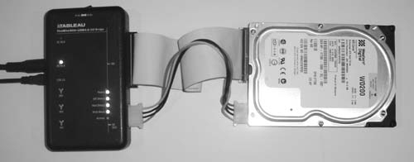
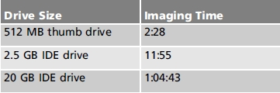
Digital Evidence Handling (cont’d.)
Figure 24-2 The UltraBlock-IDE
write-blocker connected to an IDE
hard drive
Table 24-1 Imaging times for
different-sized drives using USB 1.0

Slide 11
File Systems and Operating Systems
Forensic examination requires familiarity with:
  Different file systems structure and operation
  Operating systems
FAT
  File Allocation Table (FAT) very common
    Understanding use in floppy disks extends to hard disks
  Floppy disk information stored in blocks called sectors
    Sector contains 512 bytes of data (normally)
    Sectors arranged in groups on track

Slide 12
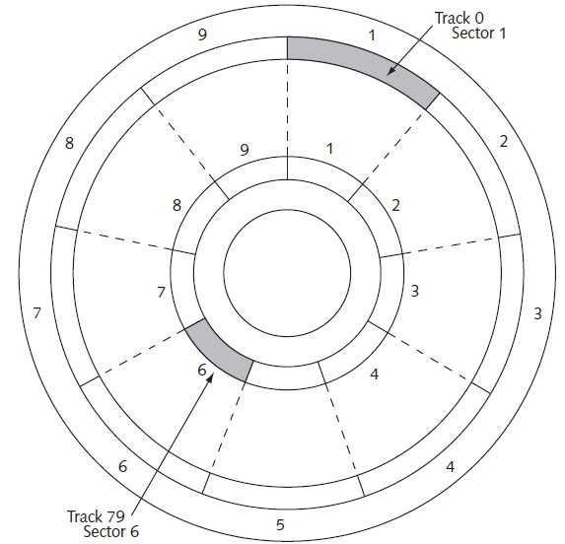

Figure 24-5 Organization of a floppy disk

Slide 13
File Systems and Operating Systems (cont’d.)
FAT (cont’d.)
  Formatted floppy disk information
    Boot sector, FAT sectors, directory sectors, data area
  FAT stores files in dynamic chains of clusters
  Advantage: no need for consecutive file clusters
  Disadvantage: fragmentation
  Cluster numbers keep FAT small and manageable
    Can result in wasted space
  Hard disk organization
    Three-dimensional
    Disk geometry: number of sectors, heads, cylinders

Slide 14
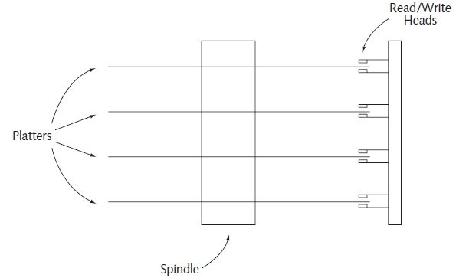
File Systems and Operating Systems (cont’d.)
Figure 24-7 Organization of a hard disk
Several FAT versions exist
  Operation always the same
Cannot recover files stored in a damaged FAT area

Slide 15
File Systems and Operating Systems
(cont’d.)
NTFS
  Created by Microsoft in 1993
  Contains features not found in FAT
  Maintains a Master File Table
    Stores metadata about every file on the volume
  Structure more complicated than FAT
    Requires around 10 MB for an “empty” file system
  Uses B+ trees for more efficient file management

Slide 16
File Systems and Operating Systems
(cont’d.)
Operating systems
  Provide the platform for computer hardware
    Made available to software applications
  Modern operating system more complex than early offerings
  Forensic examiner must understand the operating system’s inner workings and its structures and activities
    Helps determine where to look for information and evidence

Slide 17
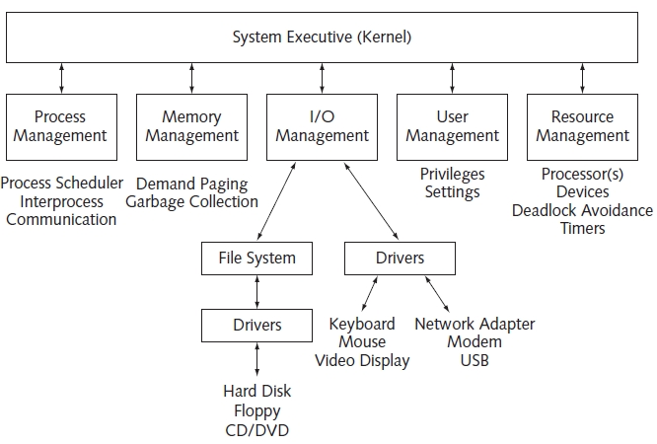
Figure 24-9 Block diagram of a modern operating system

Slide 18
File Systems and Operating Systems
(cont’d.)
Operating systems (cont’d.)
  Major sections
    Process management
    Memory management
    I/O management
    User management
    Resource management
  Kernel (System Executive)
    Ties everything together, maintains control over areas
    Of great interest to malware coders

Slide 19
Live Analysis Versus Static Analysis
Static analysis
  Performed on a CD, DVD, thumb drive, or hard disk
Live analysis
  Performed on a system powered on and running
  Can examine many more items than static analysis
  Requires tools and external storage device
    Keep track of tools, commands, evidence, date, time
  Data collection tools
    Look at specific data structures within the operating system

Slide 20
Where is the Information?
Unallocated disk clusters
  Eventually allocated and data overwritten
    Create entries in FAT or Master File Table making cluster appear assigned to a file
Bad clusters
  Trick allowing malicious code to hide itself
    Write data to unused cluster
    Mark cluster as bad (guarantees never used)
Slack space
  Part of unused cluster containing data

Slide 21
Where is the Information? (cont’d.)
Use free utilities
  Strings.exe reports on all ASCII strings in a file
Windows computers and UNIX/Linux systems
  Have many files of interest to examine
Programs available to automatically extract clues and information

Slide 22
Analyzing Network Traffic
Make sure you have permission
WireShark displays basic information about captured packets
Investigate unrecognized IP addresses or domain names
  WireShark has Follow TCP Stream tool
Other useful information
  IP address list and/or domain names that host system communicates with
  Ports used during communication sessions

Slide 23
Malware Analysis
Requires several different skills and patience
An encrypted script: Part 1
  MySpace look-alike Web page collecting usernames and passwords and spreading malware
  Captured packets contained long strings of ASCII codes
    Decoding discovered JavaScript with strange string
    Contained URL pointing to site in Hong Kong
    Ultimately downloaded malicious code

Slide 24
Malware Analysis (cont’d.)
An encrypted script: Part 2
  College Web site hacked with pornographic images
  Faculty member used WireShark Follow TCP Stream feature and found suspicious JavaScript
    Modified JavaScript to throw additional characters into decoded stream
    Prevented valid script from emerging when decoded
    Determined script was redirecting browsers opening college Web page to av-online-test.com Web site
    Whois identified owner
  Lesson: install all patches, hotfixes, and security updates in a timely manner

Slide 25
Malware Analysis (cont’d.)
Making the code harmless
  Professor provided malware program inside a password encrypted ZIP file on college Web server
  IT discovered malicious code and deleted it
  Professor provided another interesting way to load file for teaching purposes
    Cripple new piece of malware to make it harmless
    Convert crippled malware program into file containing plain-text encryption of the malware program
    Write decryption program converting plain-text encrypted file back into crippled malware program

Slide 26
Legal and Ethical Issues
Associated with computing, communication, and forensics
  Go beyond maintaining chain of custody
    Examples: honeypots, email
No rigid standard for computer ethics
  Strive to “do the right thing”
Organizations typically post their own rules governing ethical behavior
  Example: Association for Computing Machinery
Laws provide guidelines for computer and information-related crime prosecution

Slide 27
The Forensic Marketplace
Attend a forensics conference
  Businesses offer forensics hardware, forensic software, and forensic services
  Introduces emerging topics
  Expands contacts, provides valuable advice
  Training available
Conferences specializing in forensics and security
  Techno Security, SANS, Educause, ADFSL Conference on Digital Forensics, Security, and Law
Become a member of a forensic listserv

Slide 28
Troubleshooting Techniques
Power outage cripples computer
  Reboot produced MISSING OPERATING SYSTEM Boot from floppy with directory listing of C drive produced INVALID DRIVE SPECIFICATION message
  Use external USB-IDE interface to see if hard disk recognizable failed
  Moving hard drive jumpers failed
  Internet disk recovery software failed
  Local computer repair shop could not recover files
  Company specializing in data recovery
    High costs and days to recover

Slide 29
Troubleshooting Techniques (cont’d.)
Lessons learned
  Purchase a UPS
  Backup using three-fold process
  Save work frequently (on hard drive as usual)
    Save work to external USB flash drive
    Upload copy of work protected Web site
    Email copy of work
  Periodically copy files to a CD or DVD
  Print a copy for scanning if necessary

Slide 30
Summary
Incident response process contains seven steps
Resolving an incident: two-part process
Hard disk forensic copy: bit by bit duplicate
  Use with a write blocker
Understand structure and operation of different file systems and operating systems
No rigid standards governing ethics
Code of Ethics describe specific expected employee behavior
Some laws help monitor and control computers

